Slide 1
ARRAYS

Slide 2
ARRAYS
An array is a collection of similar data elements.
The elements of the array are stored in consecutive memory locations and are referenced by an index (also known as the subscript).
Declaring an array means specifying three things:
Data Type
Array Name
Array Size
Arrays are declared using the following syntax.
type name[size];

Slide 3
ARRAYS
CALCULATING THE ADDRESS OF ARRAY ELEMENTS
Address of data element, A[k] = BA(A) + w( k – lower_bound)
Here, A is the array
k is the index of the element of which we have to calculate the address
BA is the base address of the array A.
w is the word size of one element in memory, for example, size of int is 2.
CALCULATING THE LENGTH OF THE ARRAY
Length = upper_bound – lower_bound + 1
Where, upper_bound is the index of the last element
and lower_bound is the index of the first element in the array

Slide 4
ARRAYS
Operations:
Traversing of Array
Insertion in Arrays
Insert at end
Insert at front
Insert at a given position
Insert after a given value
Deletion in Arrays
Delete from end
Delete from front
Delete at a given position
Delete a given value
Linear Search
Binary Search

Slide 5





















Slide 6


















Slide 7
DELETE_LOC (Arr, SIZE, N, LOC)
Step 1. If N = = 0 then
PRINT “No data…No deletion”
End If
Step 2. If N > 0 AND LOC < N then
a. DELETE Arr [LOC]
b. Set I = LOC + 1
c. Repeat While I <= N-1 do
i. Set Arr [I-1] = Arr [I]
ii. Set I = I + 1
Done
d. DELETE Arr [N-1]
e. Set N = N – 1
Else
PRINT “LOC >= N, so no data to delete”
End If
Step 3. Exit

Slide 8


Slide 9
Binary Search
BINARY_SEARCH (A, LB, UB, VAL)
Step 1. Set BEG = LB, END = UB, POS = -1.
Step 2. Repeat While BEG <= END do
a. MID = INT (BEG+END)/2
b. If A[MID] = = VAL then
i. PRINT “Element found at MID position”
ii. POS = MID
iii. Go to Step 4.
Else If A[MID] > VAL then
END = MID - 1
Else
BEG = MID + 1
End If
Done
Step 3. If POS = = -1 then
PRINT “VAL not found”
End If
Step 4. Exit

Slide 10
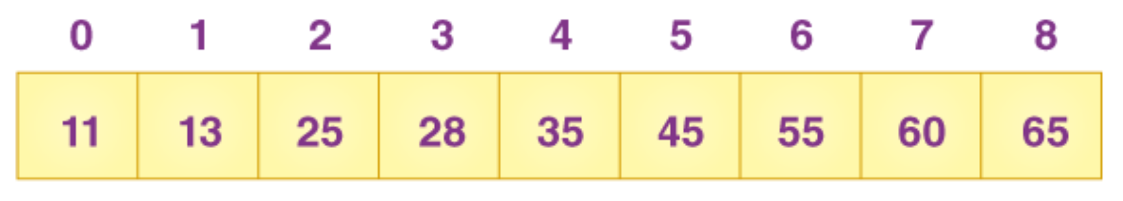

Slide 11
2-Dimensional Arrays
Rows/Columns | Col 0 | Col 1 | Col2 | Col 3 | Col 4
Row 0 | Marks[0][0] | Marks[0][1] | Marks[0][2] | Marks[0][3] | Marks[0][4]
Row 1 | Marks[1][0] | Marks[1][1] | Marks[1][2] | Marks[1][3] | Marks[1][4]
Row 2 | Marks[2][0] | Marks[2][1] | Marks[2][2] | Marks[2][3] | Marks[2][4]
Column Major:
Address(A[I][J]) = Base_Address + w{M ( J - LB) + (I - LB)}
Row major:
Address(A[I][J]) = Base_Address + w{N ( I - LB) + (J - LB)}
where, w is the number of memory bytes stored per element
M, is the number of rows
N, is the number of columns
I and J are the indices of the array element

Slide 12
2-Dimensional Arrays
Operations:
Traversing
Transpose
Creation
Addition of two matrices
Subtraction of two matrices
Multiplication of two matrices

Slide 13
2-Dimensional Arrays
TRAVERSE (A, M, N)
Step 1. Repeat For I = 0 to M-1 do
Repeat For J = 0 to N-1 do
PRINT (A[I][J])
Done
Done
Step 2. Exit

Slide 14
2-Dimensional Arrays
TRANSPOSE (A, M, N, B)
Step 1. Repeat For I = 0 to M-1 do
Repeat For J = 0 to N-1 do
Set B[J][I] = A[I][J]
Done
Done
Step 2. Repeat For I = 0 to M-1 do
Repeat For J = 0 to N-1 do
PRINT B[I][J]
Done
Done
Step 3. Exit

Slide 15
2-Dimensional Arrays
Matrix-Multiplication (X, Y, Z) // X_{m×n} multiplied by Y_{n×p} to form Z_{m×p}
Step 1. Repeat For i = 0 to m-1 do
Repeat For j = 0 to p-1 do
a. Set Z[i][j] = 0
b. Repeat For k = 0 to n-1 do
Set Z[i][j] = Z[i][j] + X[i][k] × Y[k][j]
Done
Done
Done
Step 2. Repeat For I = 0 to m-1 do
Repeat For J = 0 to p-1 do
PRINT Z[I][J]
Done
Done
Step 3. Exit

Slide 16
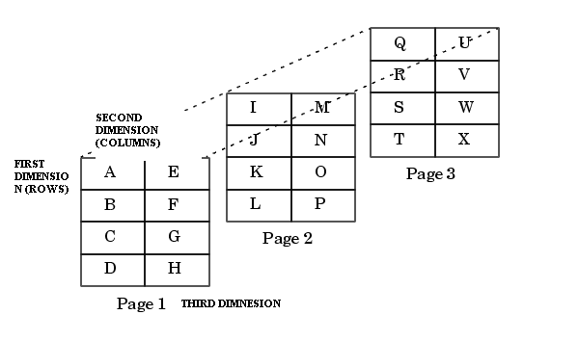
MULTI DIMENSIONAL ARRAYS
A multi dimensional array is an array of arrays.
Like we have one index in a single dimensional array, two indices in a two dimensional array, in the same way we have n indices in a n-dimensional array or multi dimensional array.

Slide 17
SPARSE MATRIX
Sparse matrix is a matrix that has many elements with a value zero.
In order to efficiently utilize the memory, specialized algorithms and data structures that take advantage of the sparse structure of the matrix should be used. Otherwise, execution will slow down and the matrix will consume large amounts of memory.
Types-
Lower Triangular matrix
Upper Triangular matrix
Diagonal matrix

Slide 18
SPARSE MATRIX
In the second variant of a sparse matrix, elements with a non-zero value can appear only on the diagonal or immediately above or below the diagonal. This type of matrix is also called a tridiagonal matrix.
In a tridiagonal matrix, A[i][j] = 0 where | i – j| > 1. Therefore, if elements are present on:
The main diagonal the, it contains non-zero elements for i=j. In all there will be n elements
Diagonal below the main diagonal, it contains non zero elements for i=j+1. In all there will be n-1 elements
Diagonal above the main diagonal, it contains non zero elements for i=j-1. In all there will be n-1 elements

Slide 19
Question 1
A program P reads in 500 integers in the range [0 to 100] representing the scores of 500 students. It then prints the frequency of each score above 50. What would be the best way for P to store the frequencies? (GATE CS 2005)
(A) An array of 50 numbers (B) An array of 100 numbers (C) An array of 500 numbers (D) A dynamically allocated array of 550 numbers

Slide 20
Question 2
Which of the following operations is not O(1) for an array of sorted data. You may assume that array elements are distinct.
(A) Find the ith largest element (B) Delete an element (C) Find the ith smallest element (D) All of the above

Slide 21
Question 3
Write an algorithm to reverse an array of unique elements in place without using any other array.
Write an algorithm to print the common elements in the given 2 sorted arrays. Assume unique element are present in the arrays and are sorted in ascending order.

